Slide 1
Global Economic and Demographic Trends Analysis
MYTHILI K S
DADS OCT BATCH

Slide 2
PROJECT SUMMARY
Data set description
Data Cleaning & Transformation
Descriptive Statistical Analysis
DAX Calculation & Measures
Data Visualizations
Dashboard
Insights & Analysis

Slide 3
Data Set Description
Data Sources :
Countries World -MySQL Database
Meta Data Country-CSV
Population per Country-CSV
GDP by Country 1960-1980-Excel
GDP by Country 1980-2000-Excel
GDP by Country 2000-2016-Excel

Slide 4
Data Cleaning & Transformation
Handled Missing Values
Removed Duplicates
Replaced Null values
Append tables
Unpivoted tables

Slide 5
Descriptive Statistical Analysis
summarized and interpret key economic and demographic data
Calculated Mean, Median, Mode, Standard Deviation
Used these statistical calculations across different countries by population, GDP values and Infant Mortality.

Slide 6
DAX Calculations
Calculated the population growth rate over time
Calculated the GDP growth rate.
Created calculated columns for GDP per capita.
Aggregated population or GDP data by region.
Derived insights such as the correlation between literacy rates and GDP.

Slide 7
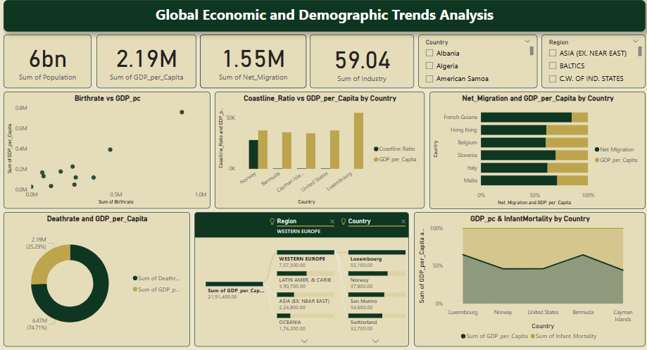
Data Visualization
Created interactive visualizations for analysing GDP trends, population dynamics, and literacy rates across regions.
Its powerful dashboards and data modelling enabled clear insights and effective storytelling for decision-making.

Slide 8
Insights
Asia has the highest Population.
Here GDP is independent of Literacy.
Country with Highest GDP per capita is Luxembourg and Lowest is Western Sahara.
Regions with Highest Population Density is Western Europe and Least is Northern America.
Birthrate is directly Proportional to GDP per capita.
GDP per capita is independent of Coastline Ratio.
Correlation between Literacy and GDP is Negative
New Caledonia records the highest GDP growth rate in these countries.
The GDP has shown a steady upward trend from 1960 to 2020, reflecting significant economic growth over the decades.

Slide 9
Recommendations
Strengthen the agricultural export products.
Countries with high coastline ratio could improve their ports and tourism.
Strengthen Healthcare in High Infant Mortality Regions.
Strengthen Infrastructure & Business Environment for GDP.
High-income countries (Luxembourg) can partner with lower-income countries (East Timor) to transfer technology and expertise.
Focus on education and vocational training to boost economic growth.
Encourage technology adoption and support local industries and Investment in Education to improve GDP per capita.
Build more schools in rural and underserved areas to improve Literacy Rates.

Slide 10
THANK YOU

